Slide 1

Notes:
1

Slide 2
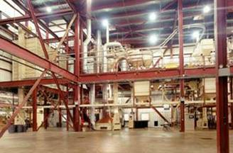
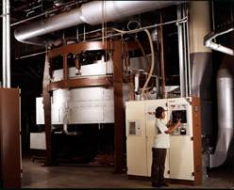
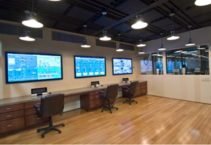
State of the Art Roasting
Six State-of-the-Art Roasters
  1 Probat R-2000
  1 Burns System 90
  2 RZ4000 “Radial Turbo” roaster
  1 Probat G-60 (small batch roaster)
  1 Probat R-3000
These roasters mean increased flexibility and product development.
Notes:
2
2

Slide 3
Commitment to Quality
As the first ISO 9001:2000 Certified coffee roaster in the US, S&D meets the highest quality standards
Consistency of product means your customers will get the same quality cup of coffee every time
Certified Kosher by the Orthodox Union
Organic Certification through Quality Assurance International (QAI)
In addition to above quality control checks we will also fund 3rd party coffee physical coffee cupping and testing
Notes:
3
3

Slide 4
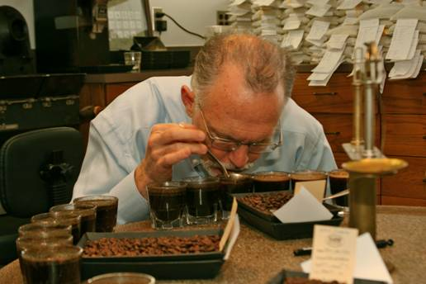
Master Cupper- Fred Taylor
Fred Taylor was introduced to the coffee business at an early age, in the early 1950's his grandfather was responsible for a coffee and Sugar operation in Puerto Rico and Cuba. As a child and during his grandfather's visits to their home, Taylor was exposed to stories about the coffee and Sugar farms and milling facilities, he soon became fascinated with the business.
Since 1962 he has continued to follow his passion and develop his palate by working with some of the most revered coffee masters in the industry.
In 1980 Mr. Taylor joined S&D Coffee and now oversees the entire commodities department. He still travels direct to the source to personally select our finest beans.
It is with Mr. Taylor’s guidance that S&D has become in involved in the following organizations:
  CQI- Coffee Quality International
  SCAA
  NCA
  Transfair
  Rainforest Alliance
  Coffee Kids
Through his experiences over the last 47 years he has developed the perfect balance of science and art when hand crafting our premium blends.

Slide 5
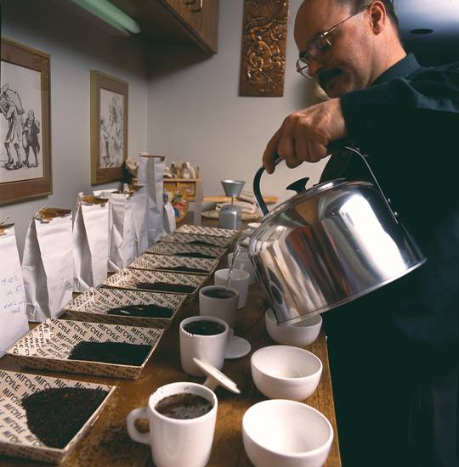
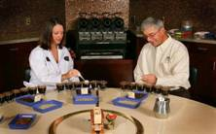
Commodities - Support Team
Joe Doyle- Director of Tea Procurement and Tea products, 29 years in coffee & tea trade
Tim Fallar- Green Coffee Buyer/Risk Manager, 28 years in coffee & tea trade
Tisha Grant- Commodities lab associate and grader

Slide 6

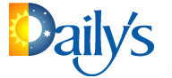






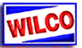





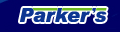
S&D Supplied C-Store Chains

Slide 7







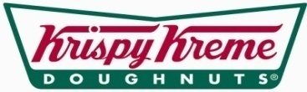







S&D Supplied Food Service Chains
Notes:
7

Slide 8
Convenience Store Mission Statement
To provide innovative solutions, service and systems for sustained, profitable growth in
the Hot Beverage category through continued research and development.
Notes:
8

Slide 9
Creating The New Coffee Culture
Strategy for Growth
Core Offering & Blend Development
Attention to Sub Category Components
Build CPD During all Dayparts
Marketing & Merchandising Support
Excellence in Execution
Quality Control Checks and Balances

Slide 10
Strategy For Growth (Continued)
Core offering and blend development process utilizing the following Sprezzi components
  -Industry Trend Analysis (Partner with NACS)
  -Competitive Landscape
  -QSR Impact
  -Circle K Consumer Trade Area Analysis
  -Spectra Demand Index
  -Circle K Corporate Strategy
  *Sprezzi (S&D proprietary data analysis system)

Slide 11

“The art of making the difficult appear effortless”

Slide 12
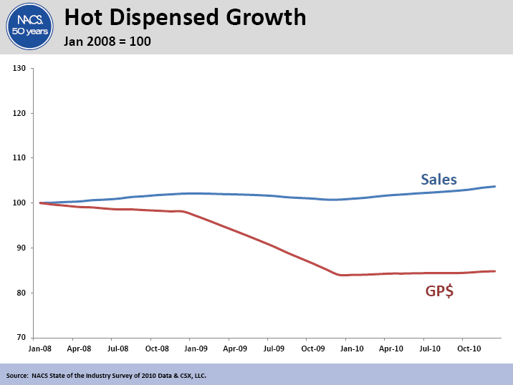

Slide 13
Source: NACS SOI Data 2010

Slide 14
Source: NACS SOI 2010 Data

Slide 15

National Coffee Drinking Trends 2011

Slide 16
There was some slight softness in cups per drinker in 2010.
This softness has reversed In 2011.

Slide 17
There are no significant changes between 2010 and 2011.
Consumers aged 40–59 tend to be the heaviest drinkers, consuming nearly 4 cups
per day. Consumers aged 18-24 are the lightest drinkers at 2.5 cups per day.

Slide 18
Consumption declines reversed in consumers aged 18-39 with numbers returning to 2009 levels. Older consumers also returned to 2009 levels, reversing growth seen between 2009 and 2010.

Slide 19
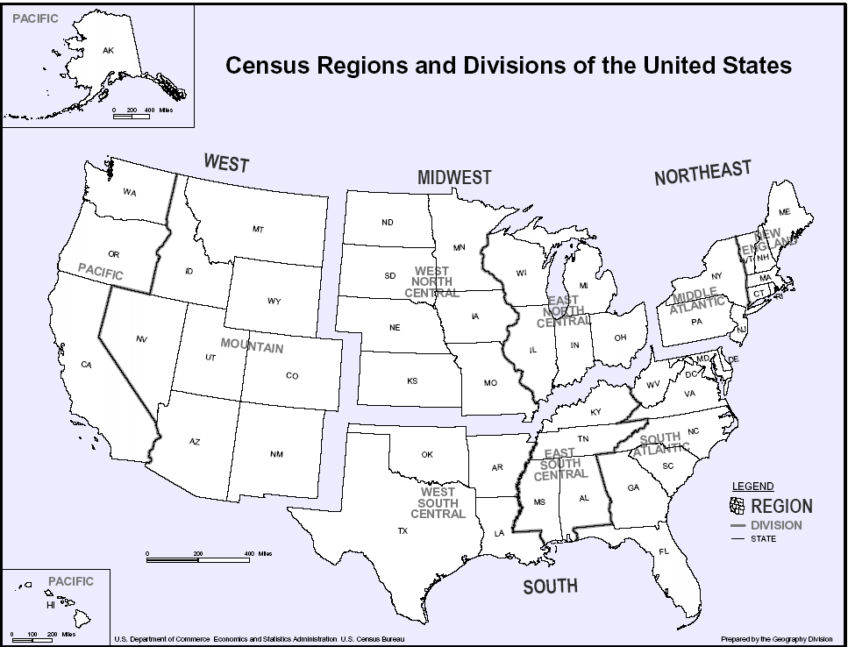

Slide 20
Overall, past day coffee penetration is very similar across the four regions. Noticeable differences are that the West places the least emphasis on Traditional – Not Gourmet and the most emphasis on Gourmet Coffee beverages. The Northeast places the most emphasis on traditional coffee.

Slide 21
In total, 85% of those who drank a brewed traditional coffee past day drank an unflavored coffee, while 18% drank a flavored coffee.

Slide 22
The overall coffee market skews toward medium (12 oz.) and small (8 oz. or less).
Only 10% of consumers claim to have drunk a large coffee yesterday.

Slide 23
Among those who have made changes way from home, the biggest change is to buy less frequently.

Slide 24
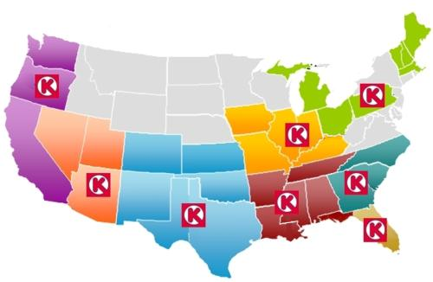
Demand Index
The Demand Index (DI) is a measure of how well something should do based on the degree of match between the demographic make-up of the item’s consumer and the geography or trade area being analyzed.

Slide 25
Source: Spectra/Nielsen Aug 2011 *Detail Available by Store

Slide 26
Consumer Coffee Profile Preferences by Division
Akron OH - QSR, Origin
Charlotte, NC – Donut Shop, Colombian, Origin
Columbus IN – Regular, QSR, Origin
Corona, CA – Donut Shop, High Caffeine, Colombian, Origin
Irving, TX - Donut Shop, High Caffeine, Colombian
Pensacola, FL – Donut Shop, Colombian
Tampa, FL – QSR, Origin
Tempe, AZ – Donut Shop, High Caffeine, Colombian
The demand for QSR and Donut Shop Blend ranks highest above average in most Circle K stores. The average consumer prefers these blend profiles and must be considered when selecting a House Blend that would appeal most to their customer base. It is recommended that S&D and Circle K choose a mainstream blend to
appeal to the consumer in these trade areas.

Slide 27
Stock Assortment
Building the Core

Slide 28
CORE OFFERING
Circle K New Premium House Blend
Circle K Premium Decaf
Circle K 100% Colombian Dark Roast
Regional offering based on consumer preference and demographics Ex: Origin Coffees in California, Texas, Ohio, Florida, Arizona
*Core offering developed on consumer preference and Demand Index

Slide 29
Building The Core
Objective
  Close the gap between top quartile performers and current Circle K performance
  Current Cups Per Day 50
  Initial goal at roll out 100 cups per day
    Set Long Term Goal to reach top NACS Quartile
      236 Cups per day

Slide 30
Blend Descriptions
CK New Premium Blend
Blend of 100% Arabica coffees from Central and South American Origins, consisting of the following:
Target Range
Brazil Santos 2/3 35% 30% - 40%
Colombian Excelso EP or better 30% 25% - 35%
Guatemalan SHB EP or better 25% 20% - 30%
Costa Rican SHB EP or better 10% 5% - 15%
In the event of unforeseen impacts to particular crops from origin, the following contingency alternative sources may be used: Nicaragua, El Salvador, and Honduras.
Blend Profile: Rich tasting and full bodied, this blend offers a fine balance of caramelized sweetness, mild citric acidity and a pleasant lingering chocolaty cocoa finish. This blend also offers mass appeal, coast to coast and will be enjoyed by coffee consumers preferring both light roast and dark roast offerings.

Slide 31
Blend Descriptions (Continued)
CK 100% Colombian Dark Roast
Target Range
Colombian Excelso EP or better 100% 100%
Excelso beans create a taste and aroma of unsurpassed quality and consistency. 100% Colombian Dark Roast has a rich sweet aroma, smooth flavor, and full body with mild acidity.
CK Premium Decaf
Target Range
Central American Arabica Decaf Coffees 65% 60% - 70%
South American Arabica Decaf Coffees 35% 30% - 40%
Colombian Gourmet Decaf – A Decaf coffee that is a superior blend of Colombian and other mild coffees, which have been formulated to deliver a rich, full-bodied flavor in a decaffeinated coffee.

Slide 32
Excellence in Execution
Action Items
Introduce Support Team
Define Support Roles
Define Execution Process
  Phoenix Success Story
  Multi-Faceted Training Programs

Slide 33
Circle K
Support
Team

Slide 34
Excellence in Execution - Corporate Team
Dale Lozier, VP of Sales Convenience Stores
Monitor green coffee buy opportunities on a regular basis
Cupping of Circle K Coffees monthly
Pre-production consultation
Sales Team Leader
Jennie Jones, VP of Marketing Convenience Store Sales Division
Evaluation of marketing opportunities quarterly
Help develop new product opportunities
Establish Category Management Objectives
Evaluation of current volumes by market consumption
Proactively work with Category Managers & Senior Sales and Marketing Manager in respect to marketing of dispensed beverages
Marketing Team Leader
Nancy Repko, Category Management Analyst
Provide and translate useful data and trend information
Support team in develop and implementation of category management strategy
Plan and help with execution of category plan
Provides insight into sales growth opportunities
Participates in store market rides
Provides Sprezzi information for promotional opportunities

Slide 35
Excellence In Execution Corporate Team (Continued)
Senior Sales and Marketing Manager, Leslie Stilwell
Assigned exclusive to Circle K and based in Charlotte office
Coordinates all program elements from each division to Senior VP, Food Service
Monitors Action Planning worksheets and dissimilates information to team members with monthly updates
Responsible for supportive focus groups/intercepts
Additional job functions to be determined based on
Circle K input

Slide 36
Excellence In Execution (Continued)
Chris Hendricks (West), John Hodnett (East) Senior National
Accounts Manager
Supervises Field Coordination Managers
Establishes Category Management objectives by Region
Establishes Training objectives and scorecard by Region
Implement and Monitor Category Management Plans by Division
with Field Coordinators.
Implement and oversee Online Survey Tool ,results and actions.
Develop training materials to ensure optimum execution and product quality
Review quarterly and year over year sales with Category Managers

Slide 37
Excellence in Execution (Continued)
Field Coordination Manager
Implement and maintain action planning worksheet Stores Rides (Division Specific)
Deliver training by Division to ensure optimum execution
and product quality
Complete online surveys at the store level “ Inspect what you expect”
Conduct equipment performance inspections
Conduct and document competitive surveys
Implement LTOs ensure timely delivery of product to Core- Mark DCs

Slide 38
“Flawless Execution” Phoenix Test
Cups Per Day Before: 88
Cups Per Day After: 143
Improved House Blend Specifications
Removed grinders to provide consistent throw weights
Calibrated all coffee equipment, temperature, pot levels and brew times.
Calibrated cappuccino equipment to established gram throw and taste profile.
Promoted key products and LTOs Origin Coffees , Seasonal and Ethnic cappuccino’s and hot chocolate

Slide 39
“Flawless Execution” Phoenix Test
(Continued)
Participated in Foodservice Task Force
Improved marketing of Coffee area
Conducted quarterly store rides with Category
Manager and District Managers.
Collaborated on store reimaging

Slide 40
Customer Beverage Training Program
S&D Coffee offers a comprehensive, multi-faceted training program to help our customers develop a successful beverage program.
It’s not hard to see the benefit of having a well-trained staff. The better they understand the product line, how to prepare, dispense, and operate the beverage equipment, the more likely customers will return to your store.
You’re really dependent upon your employees for your success because they are the ones who interact with your customers 99% of the time. If your employees are not trained, then instead of helping you build business, they can actually become a liability.
Our training program is videotaped on location, with your equipment and procedures. This allows your employees to gain a valuable real-life experience watching the training take place in their store, with their own equipment. Employees can relate to the training more effectively when it takes place with the familiar surroundings. Your employees will not only learn faster, they will also be more competent in presenting the beverage program to your customers.

Slide 41
Customer Beverage Training Program
(Continued)
What you can expect from this training program:
Increase employee’s knowledge on the care and operation of all beverage equipment.
Develop employee’s skills and knowledge on the product line, use, and preparation.
Increase beverage sales and gross profits.
Increase the number of return customers.
Create a consistent high level beverage program in all store locations.

Slide 42
Build CPD During All Dayparts
Attention to Sub Category Components
  Proprietary Cappuccino
  Revolution Hot Tea

Slide 43
Development of Proprietary
Cappuccino Products
Ability to evaluate and produce proprietary products
Eliminate Lead Time
Plan Promotions based on consumption trends by demographics
to match coffee offerings
Dayparts Menu Strategy
Quality Assurance Program
National Brand Proprietary Products –
(Hershey Varieties – Almond Joy, Heath Bar)

Slide 44
Proprietary Cappuccino
Growing Afternoon Day Part
Plan promotions based on consumer trends by demographics/coordinate with coffee offering
Design custom graphic for each promotion

Slide 45
Revolution Tea Program
Objectives:
Elevate current Hot Tea Offering with an upscale addition to the Hot Beverage program
Provide a component to allow for continued competition with coffee shops i.e. Starbucks
Differentiation that provides a competitive advantage over other channels and c-stores
Build a “One Stop” offering by attracting new consumers

Slide 46
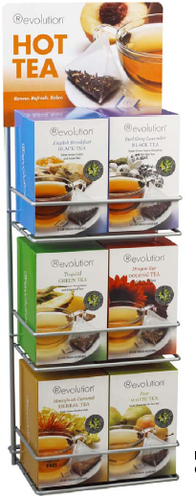

Revolution Tea
Completes the Hot Beverage Offering
On trend with consumer preferences
No labor, high profits
Customized display fixture
LTO’s

Slide 47

Market Data: Hot Tea
Demographics: Whom? Where?
  Skews toward female
  50 year olds consume more than 50%
  More than 50% of all Hot Tea is served in QSR (maintaining)
  More than 25% Mid-Scale (increasing)
  More than 15% Casual Dining (increasing)
Sources: Datessentials, StudyLogic, NPD-Crest, 2010
47

Slide 48
Market Data: Hot Tea
Sources: Datessentials, StudyLogic, NPD-Crest, 2010
48
Day-Part: When?
  Almost 50% of all Hot Tea is consumed during breakfast
  Almost 25% at lunch
  More than 20% at Dinner
  About 10% PM Snack
Notes:
48

Slide 49
Social Media Opportunities
Become a “Circle K Fan” and get a free box of tea
Free Cup of Tea Coupon on Website and Facebook
Link to REVOLUTION website to learn more…
Circle K Trivia for a Free Cup of Tea
“Join the REVOLUTION” Fans – Section for Tea Fans to Chat
Name Circle K REVOLUTIONary Retailer of the Month
  Weekly posts about Circle K on Revolution facebook page
Contests
  Facebook upload of Revolution Tea pictures with hidden Circle K’s – find them to win
  Hidden box of Revolution Tea w/gift card in store with clues posted on facebook as to where the box is (state, store, location)

Slide 50

Thank You!
Convenience Store Sales Division
Strategic & Dedicated
Notes:
50
50

